Slide 1
http://www.vidyanidhi.com/
ketkiacharya.net@gmail.com
Ketki Acharya
From: SM VITA ATC of CDAC
ketkiacharya.net@gmail.com

Slide 2
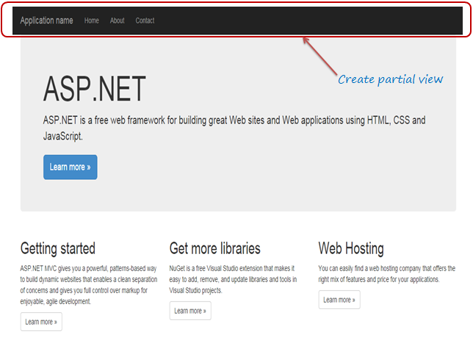
Partial View
Partial view is a reusable view, which can be used as a child view in multiple other views. It eliminates duplicate coding by reusing same partial view in multiple places. You can use the partial view in the layout view, as well as other content views.
To start with, let's create a simple partial view for the following navigation bar for demo purposes. We will create a partial view for it, so that we can use the same navigation bar in multiple layout views without rewriting the same code everywhere.

Slide 3
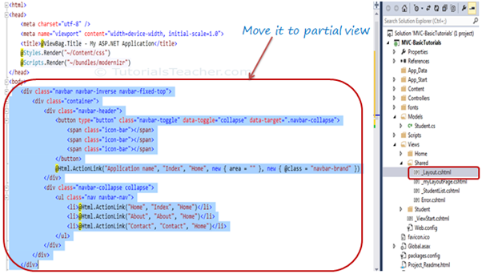
Partial View
The following figure shows the html code for the above navigation bar. We will cut and paste this code in a seperate partial view for demo purposes.

Slide 4
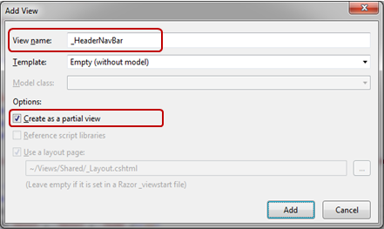
To create a partial view, right click on Shared folder -> select Add -> click on View..
Note:
If a partial view will be shared with multiple views of different controller folder then create it in the Shared folder, otherwise you can create the partial view in the same folder where it is going to be used.
In the Add View dialogue, enter View name and select "Create as a partial view" checkbox and click Add.
Partial Views
We are not going to use any model for this partial view, so keep the Template dropdown as Empty (without model) and click Add. This will create an empty partial view in Shared folder.
Now, you can cut the above code for navigation bar and paste it in _HeaderNavBar.cshtml as shown below:

Slide 5
Example: Partial View _HeaderNavBar.cshtml
<
<header>
<nav class="navbar navbar-expand-sm navbar-toggleable-sm navbar-light bg-white border-bottom box-shadow mb-3">
<div class="container-fluid">
<a class="navbar-brand" asp-area="" asp-controller="Home" asp-action="Index">MVC_Core</a>
<button class="navbar-toggler" type="button" data-bs-toggle="collapse" data-bs-target=".navbar-collapse" aria-controls="navbarSupportedContent"
aria-expanded="false" aria-label="Toggle navigation">
<span class="navbar-toggler-icon"></span>
</button>
<div class="navbar-collapse collapse d-sm-inline-flex justify-content-between">
<ul class="navbar-nav flex-grow-1">
<li class="nav-item">
<a class="nav-link text-dark" asp-area="" asp-controller="Home" asp-action="Index">Home</a>
</li>
<li class="nav-item">
<a class="nav-link text-dark" asp-area="" asp-controller="Home" asp-action="Privacy">Privacy</a>
</li>
</ul>
</div>
</div>
</nav>
</header>
Thus, you can create a new partial view. Let's see how to render partial view.

Slide 6
<!DOCTYPE html><html><head>
<meta charset="utf-8" />
<meta name="viewport" content="width=device-width, initial-scale=1.0"> <title>@ViewBag.Title - My ASP.NET Application</title>
@Styles.Render("~/Content/css")
@Scripts.Render("~/bundles/modernizr")
</head><body>
<partial name="_Header.cshtml">
<div class="container body-content">
@RenderBody() <hr />
<footer>
<p>&copy; @DateTime.Now.Year - My ASP.NET Application</p>
</footer>
</div>
@Scripts.Render("~/bundles/jquery")
@Scripts.Render("~/bundles/bootstrap")
@RenderSection("scripts", required: false)
</body></html>

Slide 7
Client
Reponse as HTML
Layout
Part of data
The following example references a partial view with a relative path:
CSHTML
@await Html.PartialAsync("../Account/_LoginPartial.cshtml")
Alternatively, you can render a partial view with RenderPartialAsync. This method doesn't return an IHtmlContent. It streams the rendered output directly to the response. Because the method doesn't return a result, it must be called within a Razor code block:
CSHTML
@{ await Html.RenderPartialAsync("_AuthorPartial"); }
Since RenderPartialAsync streams rendered content, it provides better performance in some scenarios.
In performance-critical situations, benchmark the page using both approaches and use the approach that generates a faster response
Client
Reponse as HTML
Part of data
Layout

Slide 8
Tag Helpers compared to Web Server Controls
Tag Helpers don't own the element they're associated with; they simply participate in the rendering of the element and content. ASP.NET Web Server Controls are declared and invoked on a page.
ASP.NET Web Server Controls have a non-trivial lifecycle that can make developing and debugging difficult.
Web Server controls allow you to add functionality to the client DOM elements by using a client control. Tag Helpers have no DOM.
Web Server controls include automatic browser detection. Tag Helpers have no knowledge of the browser.
Multiple Tag Helpers can act on the same element (see Avoiding Tag Helper conflicts) while you typically can't compose Web Server controls.
Tag Helpers can modify the tag and content of HTML elements that they're scoped to, but don't directly modify anything else on a page. Web Server controls have a less specific scope and can perform actions that affect other parts of your page; enabling unintended side effects.
Web Server controls use type converters to convert strings into objects. With Tag Helpers, you work natively in C#, so you don't need to do type conversion.
Web Server controls use System.ComponentModel to implement the run-time and design-time behavior of components and controls. System.ComponentModel includes the base classes and interfaces for implementing attributes and type converters, binding to data sources, and licensing components. Contrast that to Tag Helpers, which typically derive from TagHelper, and the TagHelper base class exposes only two methods, Process and ProcessAsync.

